Slide 1
String Object
Intro to String Object | Searching and Replacing | Other Sting Methods | Template Literals
Notes:
Welcome to our lecture on string objects. In this lecture we will go through introduction to string object, searching and replacing a string, some other string methods, template literals. Let’s start our lecture.

Slide 2
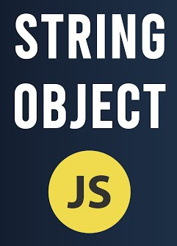
Introduction to String Object
String Object: Defines methods to manipulate strings, extract substrings, and test for string inclusion; string literals are auto-converted to String objects when a method is called.
charAt(): Returns the character at a specified index (e.g., "test".charAt(1) returns "e"); returns an empty string if the index is out of bounds.
length: Returns the number of characters in a string (e.g., "test".length returns 4).
Notes:
The String object in JavaScript provides methods to manipulate strings, extract substrings, and check for string inclusion. String literals are automatically converted to String objects when methods are called. The char At method retrieves a character at a specific index, while the length property returns the total number of characters in a string. These tools are essential for working with text in JavaScript.

Slide 3
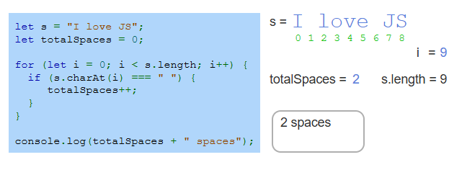
Example of Counting Spaces in String
Notes:
This example counts spaces in a string using a for loop. The string "I love JS" is iterated character by character using the char At method. Each time a space is encountered, the totalSpaces counter is incremented. At the end, the total number of spaces is logged as "2 spaces." This demonstrates how to analyze strings and count specific characters efficiently in JavaScript.

Slide 4
Searching and replacing
The String object provides methods to search and replace strings:
indexOf(): Returns the first occurrence index of a search string or -1 if not found.
lastIndexOf(): Returns the last occurrence index of a search string or -1 if not found.
replace(): Replaces one string with another and returns the updated string.
Notes:
The String object in JavaScript offers methods for searching and replacing text. The index Of method returns the index of the first occurrence of a substring or -1 if not found. The last Index Of method finds the last occurrence of a substring or returns -1 if absent. The replace method allows replacing a substring with another, returning the updated string. These tools simplify text manipulation tasks.

Slide 5
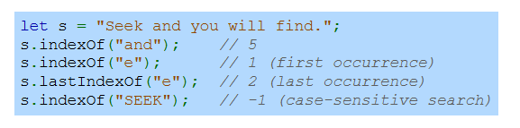
Example
Searching for a string with indexOf() and lastIndexOf().
Notes:
This example demonstrates searching a string using index of and last Index of methods. The string Seek and you will find is used. Index of returns the first occurrence of and at index 5 and e at index 1. last Index of finds the last occurrence of e at index 2. Searching for SEEK returns -1 since the search is case sensitive. These methods help locate substrings efficiently in JavaScript.

Slide 6
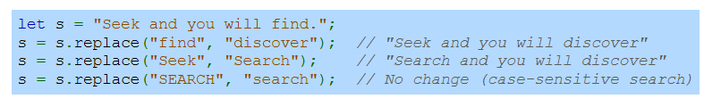
Example
Replacing a string with replace().
Notes:
This example shows how to replace substrings using the replace method. In the string Seek and you will find replacing find with discover updates it to Seek and you will discover. Replacing Seek with Search changes it to Search and you will discover. However, replacing SEARCH with search makes no change, as replace is case sensitive. This demonstrates efficient string updates.

Slide 7
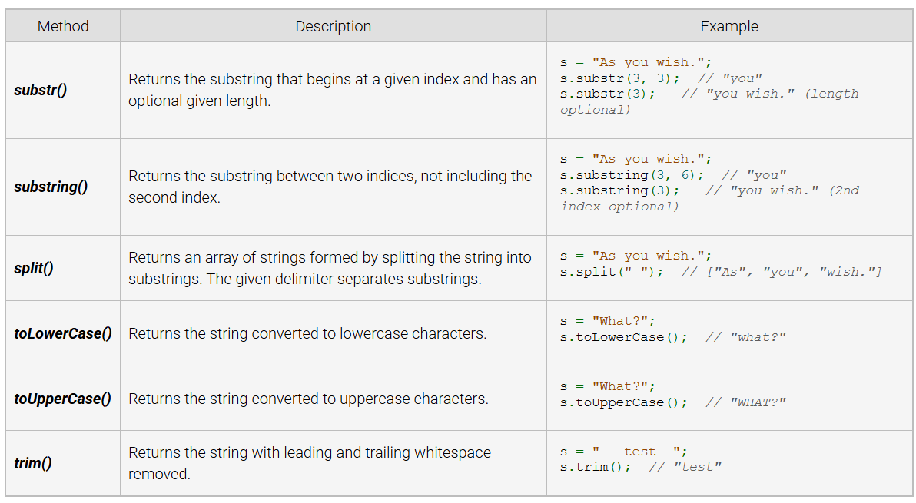
Other String Methods
Notes:
Here are additional string methods in JavaScript. The sub str and substring methods extract parts of a string based on indices. The split method divides a string into an array using a delimiter. The to Lower Case and to Upper Case methods change the string to lowercase or uppercase. Finally, the trim method removes leading and trailing whitespace. These methods simplify string manipulation tasks.

Slide 8
Template literals
Definition: Template literals are strings enclosed in backticks (`) that support embedding expressions.
Syntax: Expressions are embedded using ${expression} (e.g., `test ${1 + 2}` evaluates to "test 3").
Benefit: Eliminates the need for string concatenation, making string construction cleaner and more readable.
Notes:
Template literals are strings enclosed in backticks, allowing embedded expressions using the dollar expression syntax. For example, test dollar 1 plus 2 evaluates to test 3. This eliminates the need for string concatenation, making string construction cleaner and more readable. Template literals are especially useful for dynamic strings and multi line text, improving code clarity and efficiency.

Slide 9
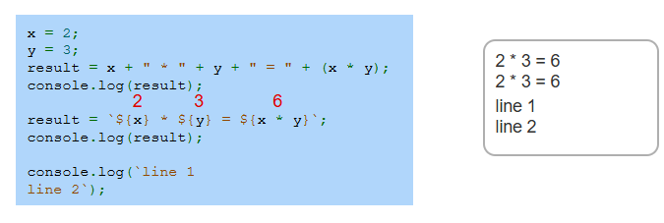
Example
Notes:
This example shows how template literals simplify string construction. Without template literals, concatenation is used to combine values like x asterisk y equal to 6. With template literals, expressions are embedded using dollar expression, producing the same result more cleanly. Additionally, template literals support multi line strings, as shown in line 1 line 2. This enhances readability and reduces code complexity. Thanks for watching the lecture.

